Slide 1
PyQt5 kutubxonasi bilan tanishish va o’rnatish Qt Designer yordamida ilovanong oynasini yaratish

Slide 2
PyQt5
PyQt5 – Digia tomonidan Qt5 platformasiga asoslangan grafik foydalanuvchi interfeysini yaratish uchun Python kutubxonasi.
U Python 2.x va 3.x variantlari uchun mavjud.
Qt kutubxonasi eng yaxshi va kuchli GUI kutubxonalaridan biridir.

Slide 3
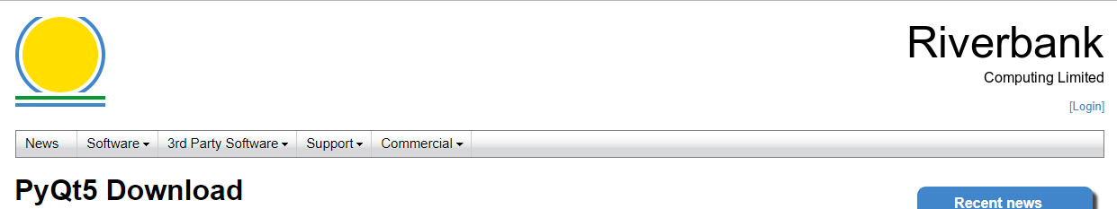


O`rnatish

Slide 4
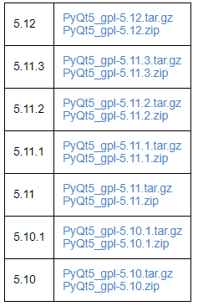
O`rnatish
PyQt5 - python modullari majmui sifatida amalga oshiriladi. Ushbu kutubxonada 620 dan ortiq sinflar va 6000 dan ortiq funktsiyalar va usullar mavjud.
Unix, Windows va Mac OS kabi barcha asosiy operatsion tizimlarida ishlovchi multiplatformli kutubxona.

Slide 5
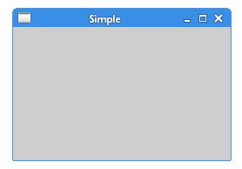
PyQt5 QtWidgets
import sys
from PyQt5.QtWidgets import QApplication, QWidget
if __name__ == '__main__':
app = QApplication(sys.argv)
w = QWidget()
w.resize(250, 150)
w.move(300, 300)
w.setWindowTitle('Simple')
w.show()
sys.exit(app.exec_())

Slide 6
PyQt5 QtWidgets Class, QIcon
from PyQt5.QtWidgets import QApplication, QWidget
from PyQt5.QtGui import QIcon
class Example(QWidget):
if __name__ == '__main__':
app = QApplication(sys.argv)
ex = Example()
sys.exit(app.exec_())

Slide 7
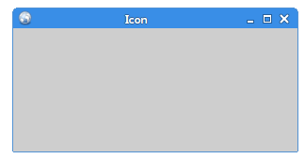
PyQt5 QtWidgets Class
class Example(QWidget):
def __init__(self):
super().__init__()
self.initUI()
def initUI(self):
self.setGeometry(300, 300, 300, 220)
self.setWindowTitle('Icon')
self.setWindowIcon(QIcon('web.png'))
self.show()

Slide 8
PyQt5.QtWidgets - QWidget, QToolTip, QPushButton, Qapplication, QFont
import sys
from PyQt5.QtWidgets import (QWidget, QToolTip,
QPushButton, QApplication)
from PyQt5.QtGui import QFont
class Example(QWidget):
if __name__ == '__main__':
app = QApplication(sys.argv)
ex = Example()
sys.exit(app.exec_())

Slide 9
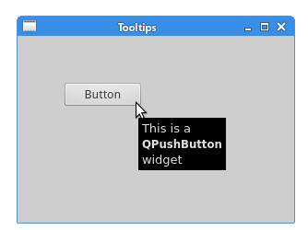
PyQt5.QtWidgets - QWidget, QToolTip, QPushButton, Qapplication, QFont
class Example(QWidget):
def __init__(self):
super().__init__()
self.initUI()
def initUI(self):
QToolTip.setFont(QFont('SansSerif', 10))
self.setToolTip('This is a <b>QWidget</b> widget')
btn = QPushButton('Button', self)
btn.setToolTip('This is a <b>QPushButton</b> widget')
btn.resize(btn.sizeHint())
btn.move(50, 50)
self.setGeometry(300, 300, 300, 200)
self.setWindowTitle('Tooltips')
self.show()

Slide 10
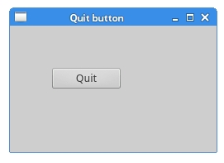
QCoreApplication
def initUI(self):
qbtn = QPushButton('Quit', self)
qbtn.clicked.connect(QCoreApplication.instance().quit)
qbtn.resize(qbtn.sizeHint())
qbtn.move(50, 50)
self.setGeometry(300, 300, 250, 150)
self.setWindowTitle('Quit button')
self.show()

Slide 11
Message Box - QMessageBox
def initUI(self):
self.setGeometry(300, 300, 250, 150)
self.setWindowTitle('Message box')
self.show()

Slide 12
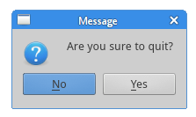
Message Box - QMessageBox
def closeEvent(self, event):
reply = QMessageBox.question(self, 'Message',
"Are you sure to quit?", QMessageBox.Yes |
QMessageBox.No, QMessageBox.No)
if reply == QMessageBox.Yes:
event.accept()
else:
event.ignore()

Slide 13
QDesktopWidget – ekranni markazdan joylashtirish
def initUI(self):
self.resize(250, 150)
self.center()
self.setWindowTitle('Center')
self.show()
def center(self):
qr = self.frameGeometry()
cp = QDesktopWidget().availableGeometry().center()
qr.moveCenter(cp)
self.move(qr.topLeft())

Slide 14

Design Simple Dialog Using PyQt5 Designer

Slide 15
Kerakli vositalar
Editor: Visual Studio Code
Python: 3.6
PyQt5 Libraries: All

Slide 16
PyQt5 Designer, tools, and packages.
pip install pyqt5-installer
pip install pyqt5
pip install pyqt5-tools

Slide 17
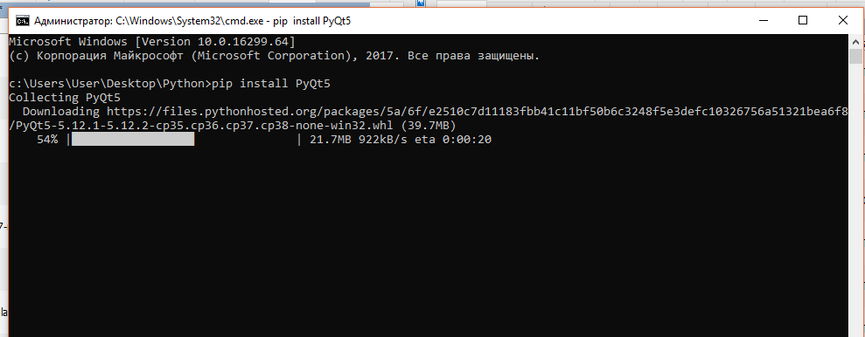

Slide 18
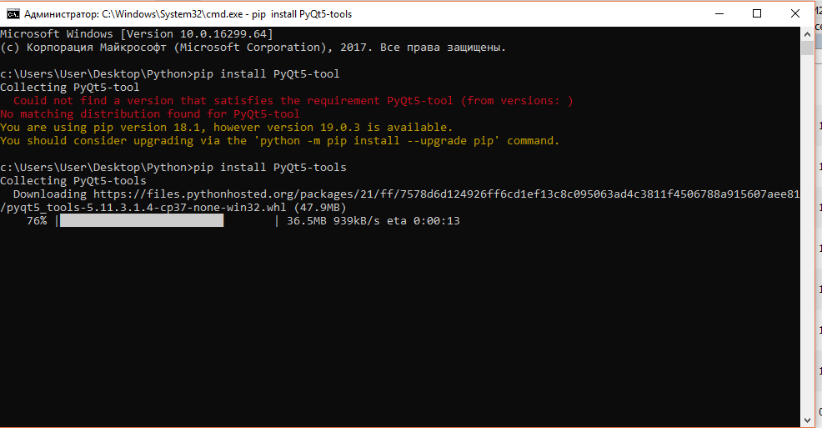

Slide 19
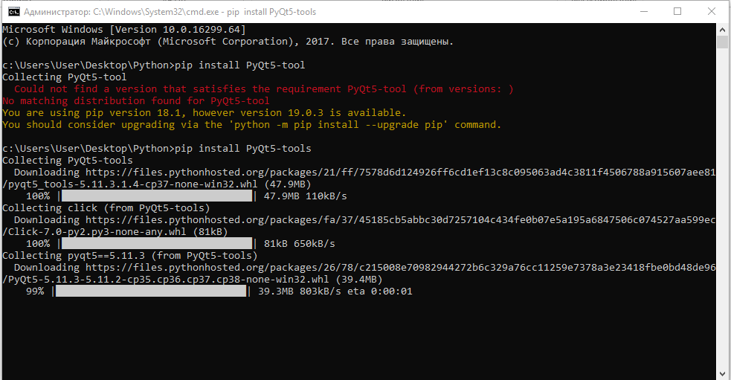

Slide 20
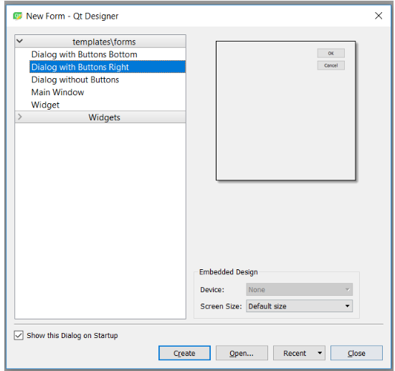
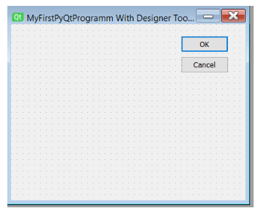
Start the PyQt5 Designer
C:\Program Files (x86)\Python36-32\Lib\site-packages\pyqt5-tools and locate designer.exe.

Slide 21
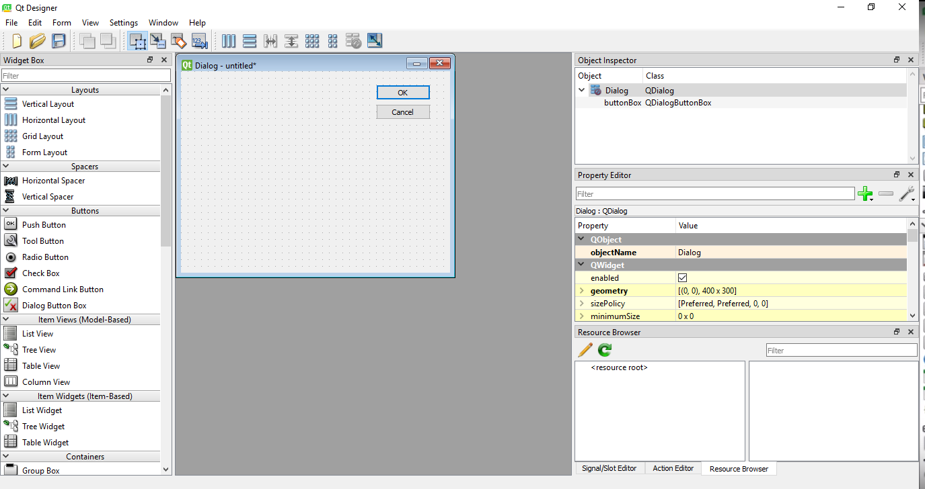

Slide 22
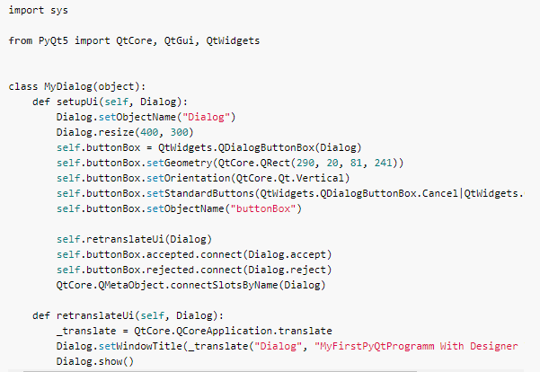
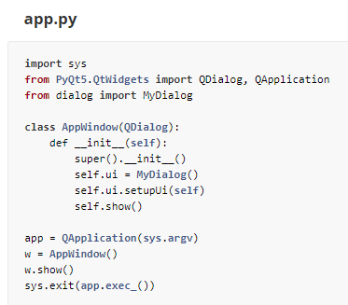
Converting dialog.ui to dialog.py

